Slide 1


Slide 2
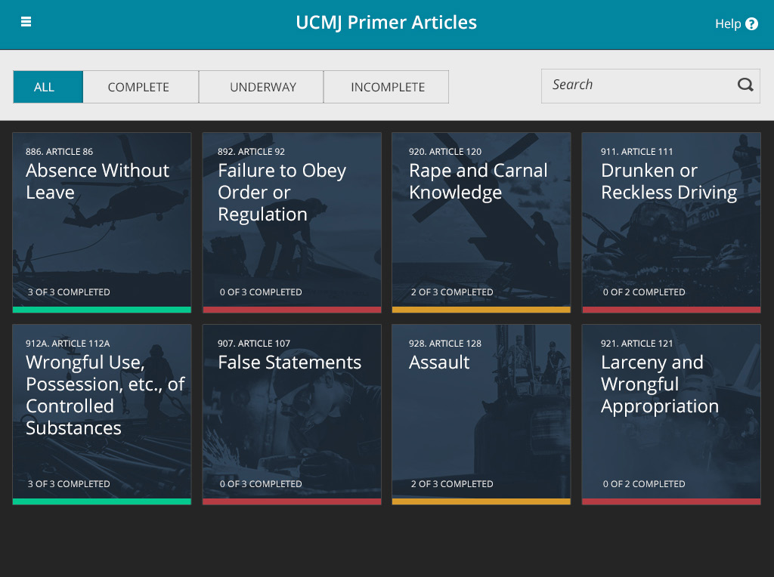
Need a way to access all of the text articles.
Should be 1 of 2 completed and be yellow vs. red.

Slide 3
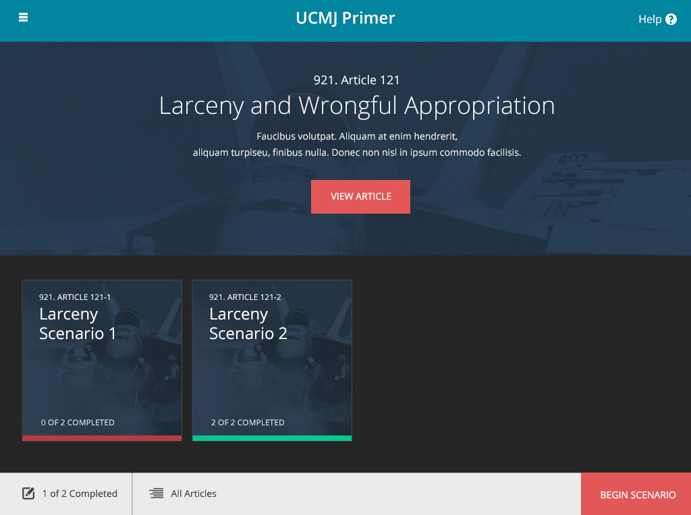
Should be 1 of 2 completed.

Slide 4
List all of the full articles, but scroll set to the area of focus.
UCMJ ARTICLES
X
921. ARTICLE 121. LARCENY AND WRONGFUL APPROPRIATION
Any person subject to this chapter who wrongfully takes, obtains, or withholds, by any means, from the possession of the owner or of any other person any money, personal property, or article of value of any kind–
with intent permanently to deprive or defraud another person of the use and benefit of property or to appropriate it to his own use or the use of any person other than the owner, steals that property and is guilty of larceny; or
with intent to temporarily to deprive or defraud another person of the use and benefit of property or to appropriate to his own use the use of any person other than the owner, is guilty of wrongful appropriation.
Any person found guilty of larceny or wrongful appropriation shall be punished as a court-martial may direct.

Slide 5
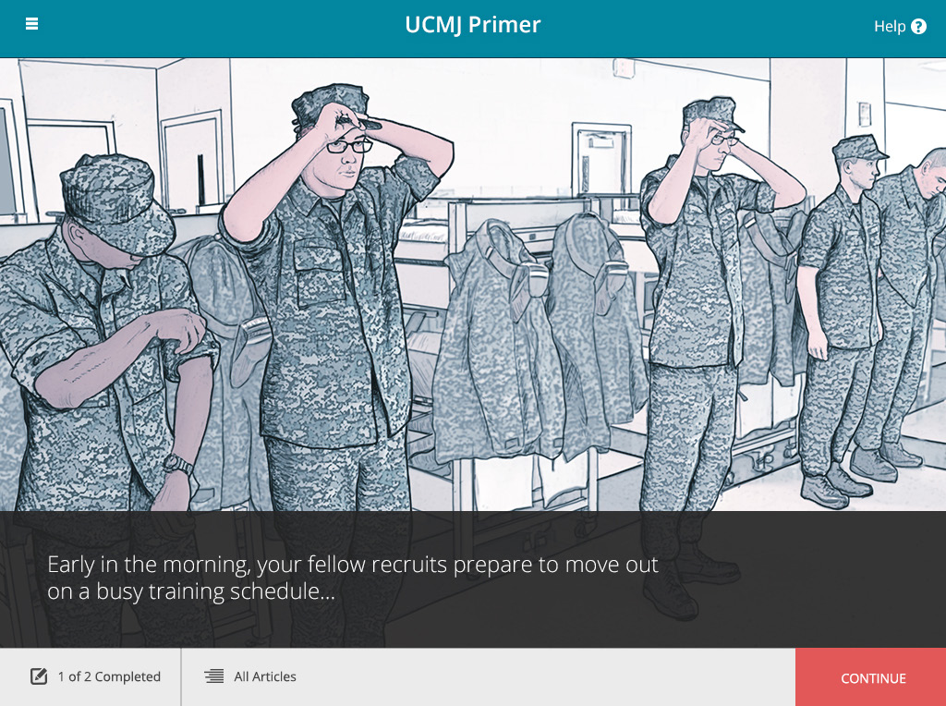
Not sure if this adds anything. Perhaps this should be the name of the Article (some get long).
Takes you back to the home screen (not intuitive).

Slide 6
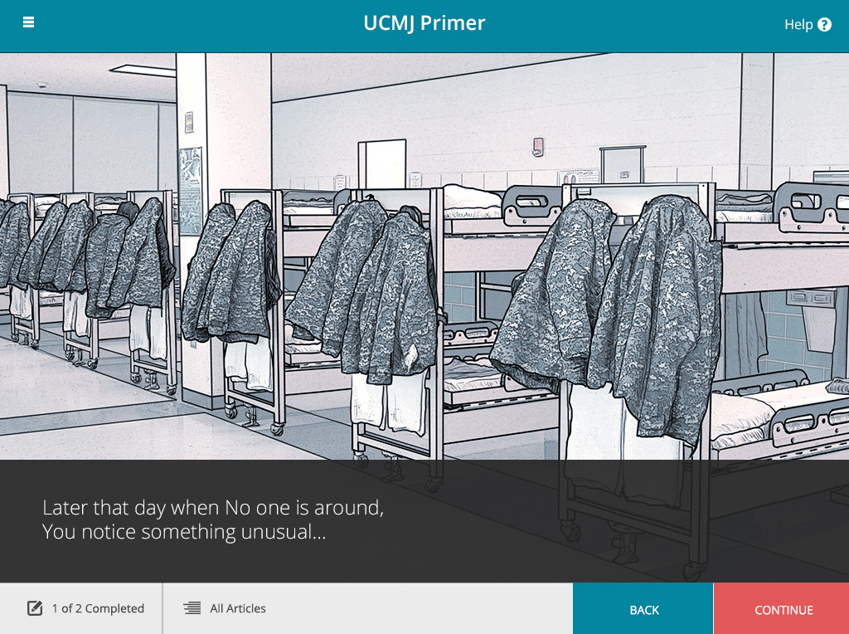
Later that day when no one is around, you notice something unusual…

Slide 7
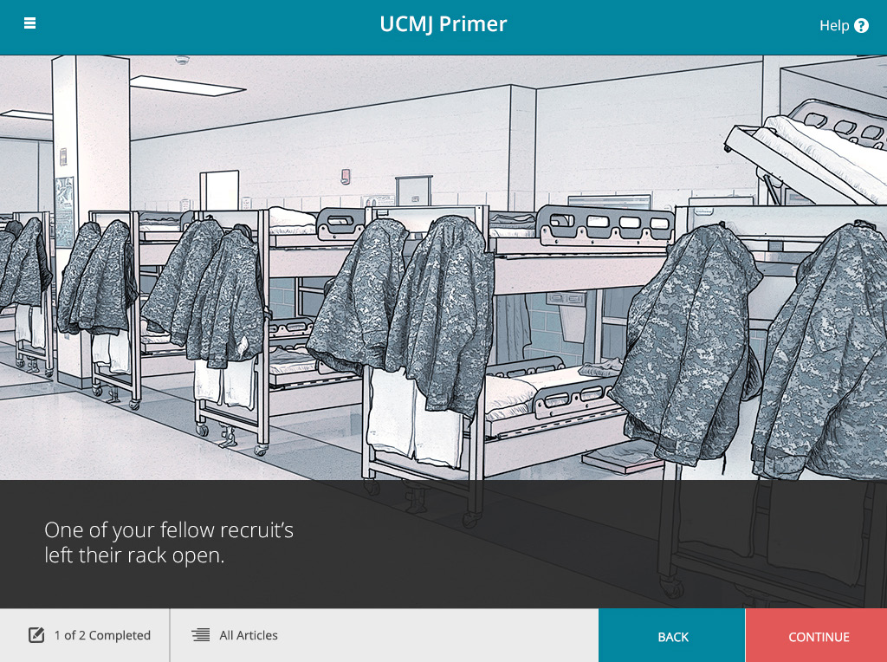
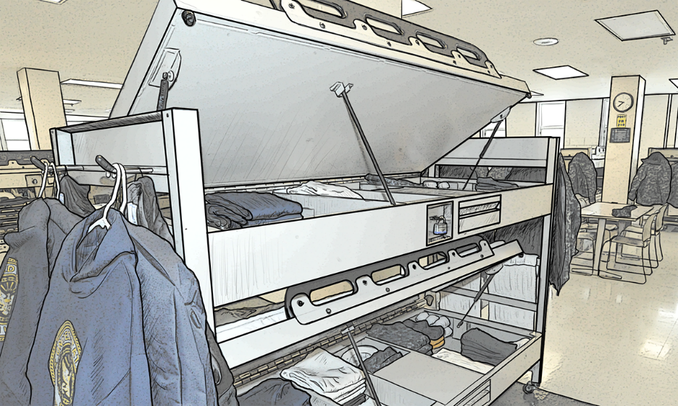
This is the wrong picture.
Text goes with this image.

Slide 8
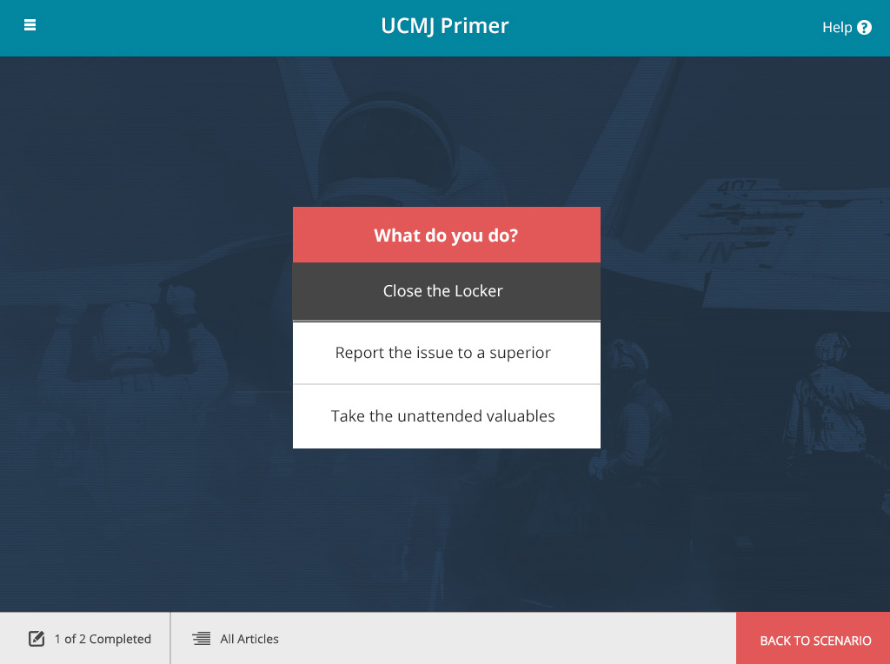
Make background a fade of the last page vs equipment.

Slide 9
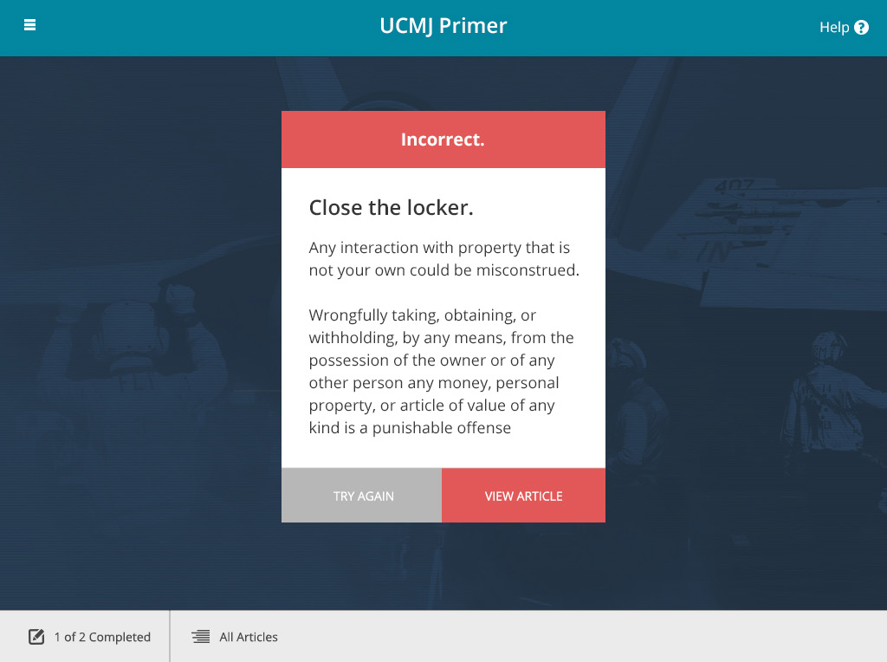
Incorrect all caps?
What would happen once you got it right? Would it take you back to the home page or the first article page?

